Slide 1
Where should the Marketing Department cast their net
Kickstarter Projects in the spotlight

Slide 2
Meet the Projects
Dance Projects have the most successful goal fulfillment with 65% of projects hitting their goal.
ART
COMICS
CRAFT
DANCE
DESIGN
FASHION
FILM AND VIDEO
FOOD
GAMES
JOURNALISM
MUSIC
PHOTOGRAPHY
PUBLISHING
TECHNOLOGY
THEATER
Followed by
Theater with 63%
Comics with 54%
&
Music with 52%

Slide 3
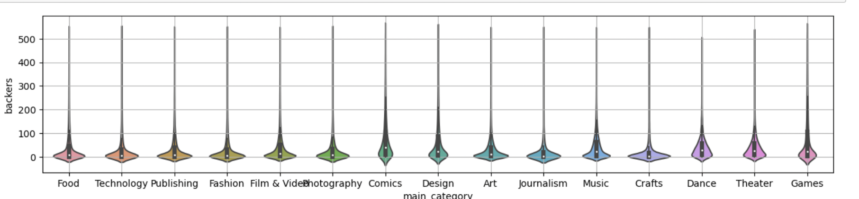
Who’s Buying
With a more stretched out shape, categories like
Comics, Dance and Games on average have more backers
A Project has on average 45 backers (Individuals who donate money to the project)
A successful Project has on aver 96 people financially invested in the project
Density of Backers Per Main Category

Slide 4
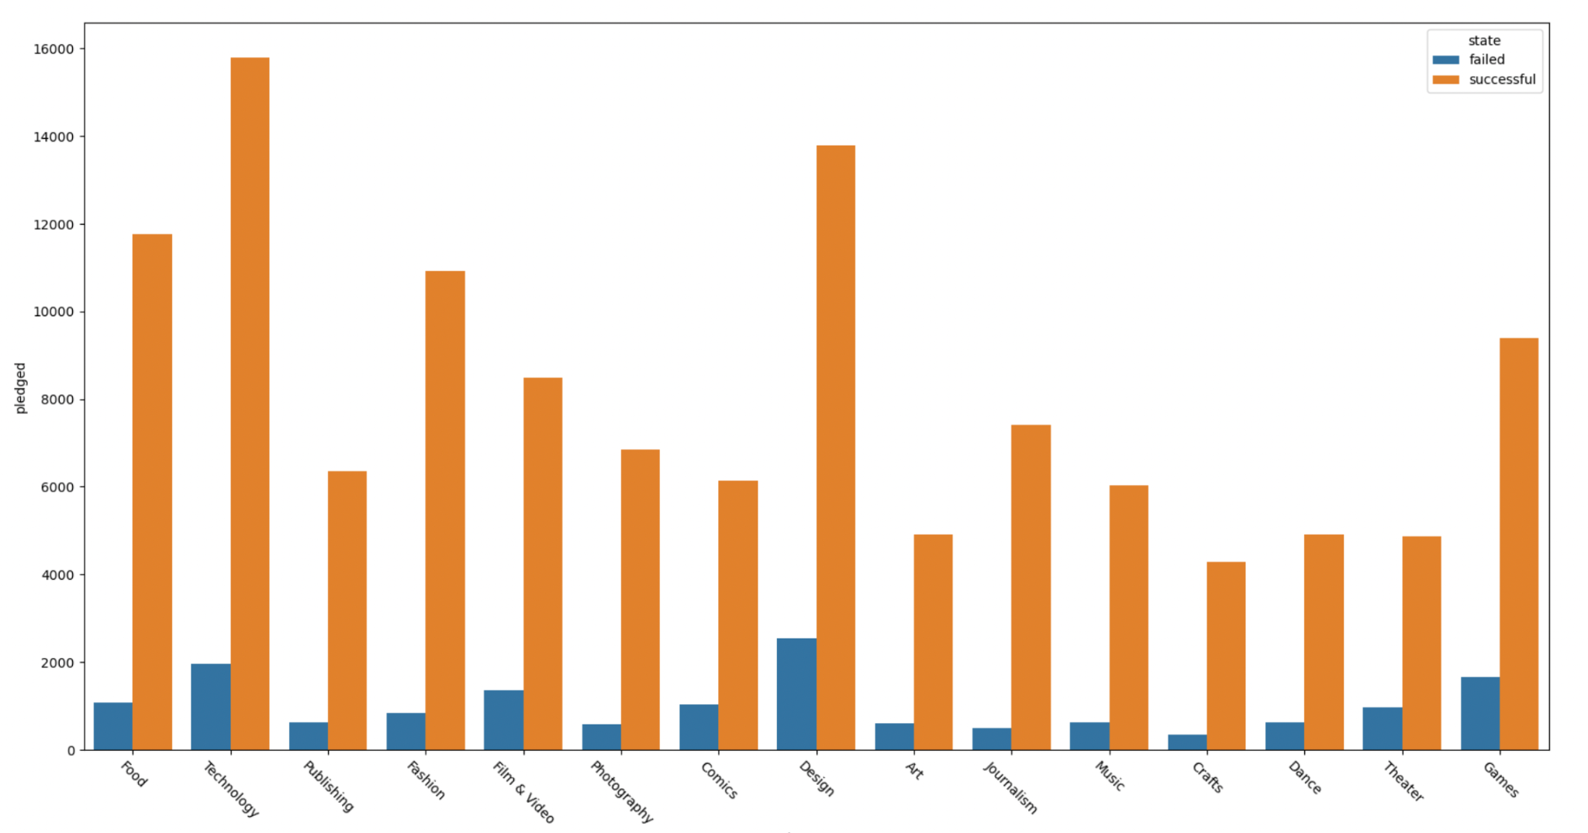
Where’s the money going?
Tech, Design, Food and Fashion are the top performing successful projects
Successful projects in these categories have on average higher pledge totals
PLEDGE TOTAL BY STATE AND CATEGORY

Slide 5
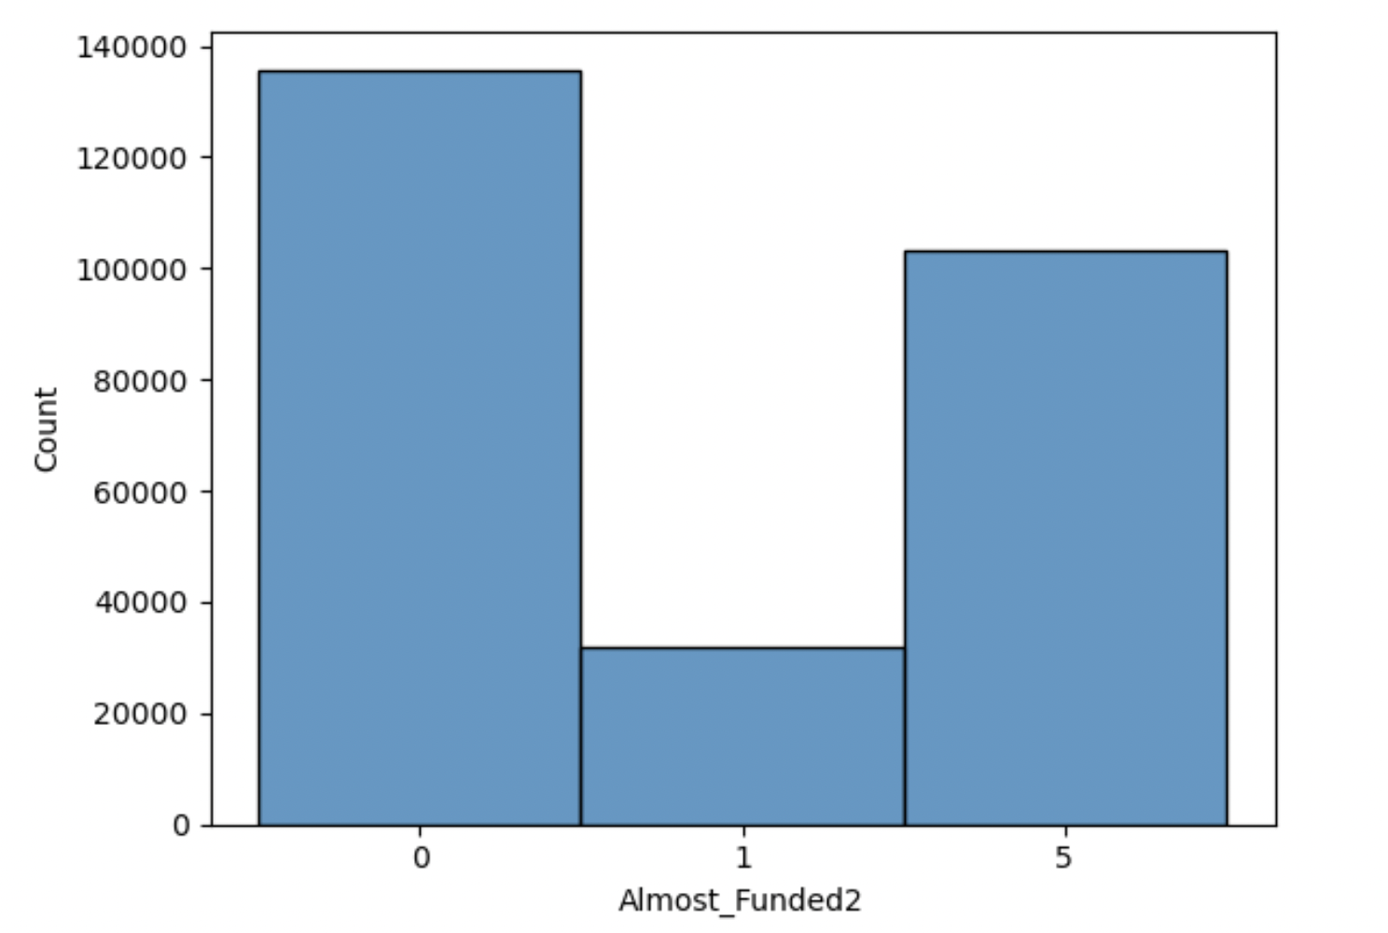
Projects on the Brink
Average pledge total is 3,600$
Projects in the Almost Funded column are 1,500$ short of their goal
Top ten categories in Almost Funded include
Music
Film
Publishing
Art
Fashion
Games
Food
Craft
Design
Tech
Key
1 = Almost funded
0 = Not close to being funded
5 = Successful

Slide 6
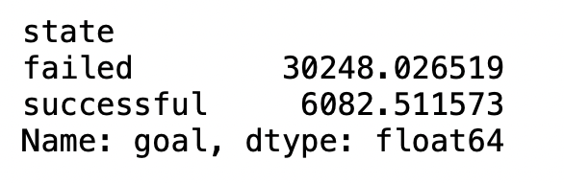
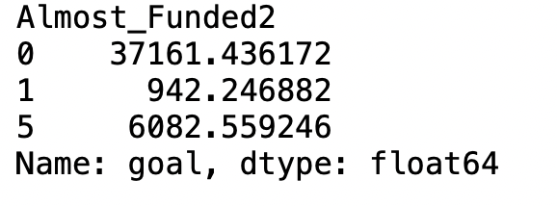
Where Should the Spotlight Go
The average project that is almost funded is more likely to have a goal that is 6 times less than the standard successful project
AVERAGE GOAL BY FULFILLMENT
AVERAGE GOAL FOR ALMOST FUNDED

Slide 7
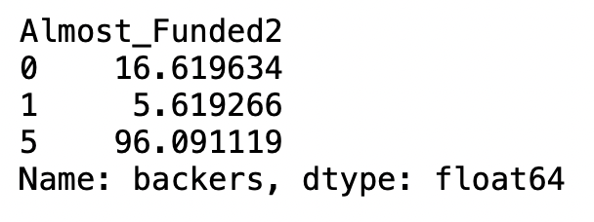
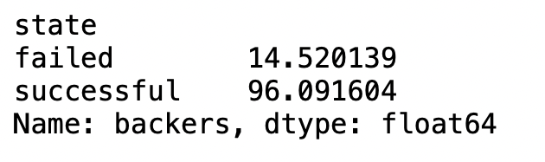
Where Should the Spotlight Go
The average project that is almost funded is more likely to have 19 times less Backer than the standard successful project
AVERAGE GOAL BY FULFILLMENT
AVERAGE GOAL FOR ALMOST FUNDED

Slide 8
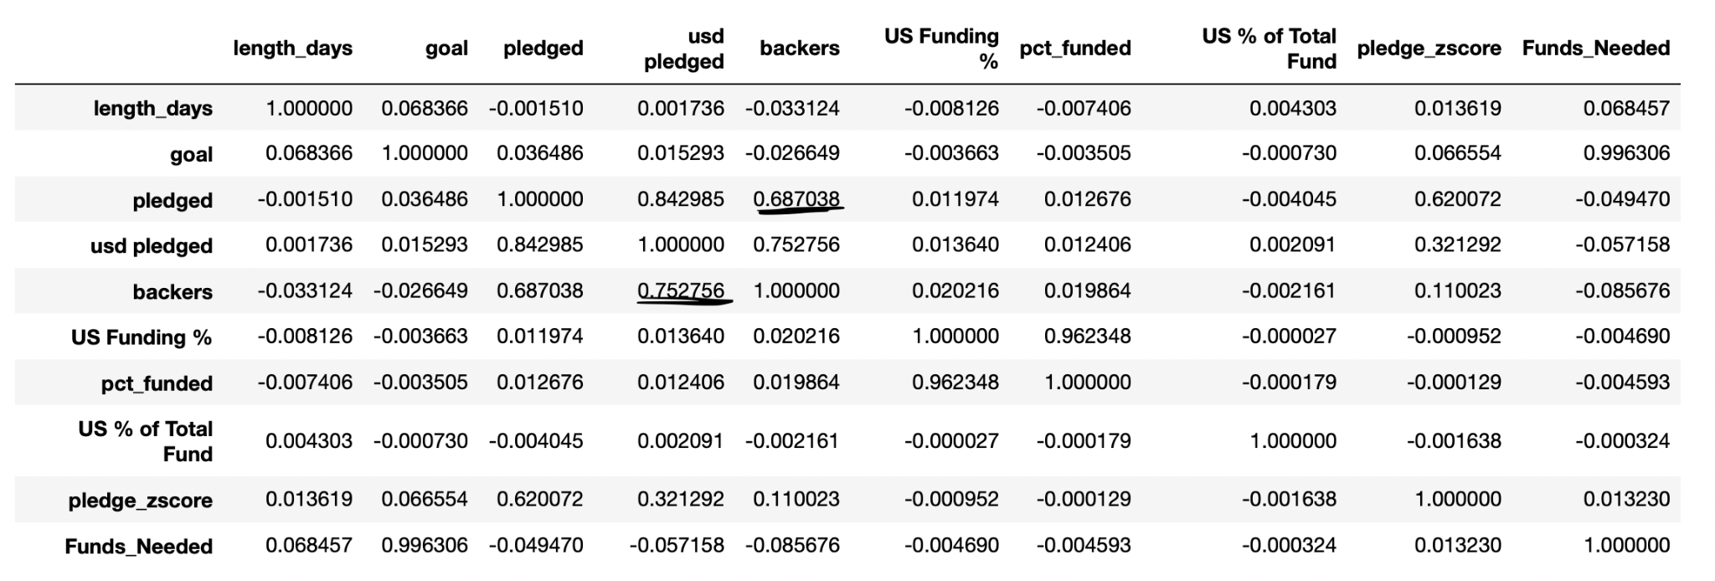
More Backers More Bucks
There is a moderately positive correlation between the Backers and the amount pledged both domestic and in total

Slide 9
In Conclusion
Let’s shine a light on projects that need that extra boost of funding such as Music, Publishing, Craft and Tech
There goals can often be smaller than the average project. A little boost goes a long way
More backers can help project attain their goal which is where marketing comes in!

